Slide 1
Play and Learn with PYTHON

Slide 2
TEAM MEMBERS:
Greidi Gjoka
Indrit Breiti
Kejsi Bushi
Klea Xhina
Rubin Aga

Slide 3
What you will see on our project
A brief explanation of the topic of the project
User characteristics
Diagrams
Game Design
Explanation on how the game works
Workspace

Slide 4
What is the purpose of this project?
Almost every high school in Albania offers what are called "IT " classes where students start to understand more about technology and specifically programming.
Not everyone finds coding intriguing, so the purpose of this project is to make students change their opinion regarding programming.

Slide 5
How did we aim to achieve our goal?
Our group created a game using python, which consisted of a fox that will grab coins, and at a specific moment, the game will pause, to continue only if the user answers a random question correctly. These questions are related to programming but asked in other ways so the user would find this game entertaining, but at the same time, the student will learn more about coding.

Slide 6

How did we aim to achieve our goal?
We created a simple game using python. The user plays the game by controlling the character of a fox. The goal is to collect as many coins as you can. To collect coins, however the user needs to answer some interactive questions!

Slide 7
Project Planning
It is important to have a structured plan in order to have the best product in the end.
For this reason, we prepared Gantt Chart and Pert table

Slide 8
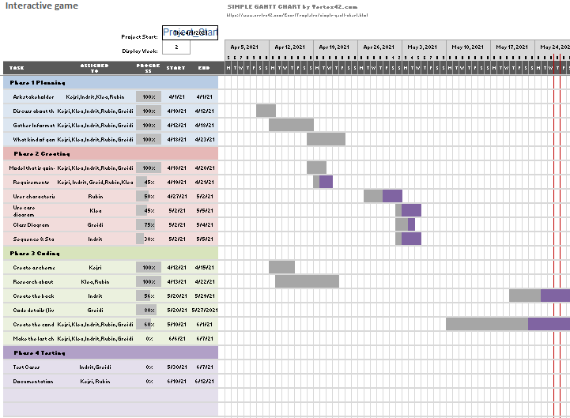
GANTT CHART ~ PREPARED BY KEJSI BUSHI

Slide 9
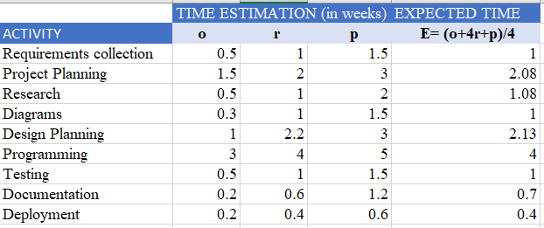
PERT TABLE~ PREPARED BY RUBIN AGA

Slide 10
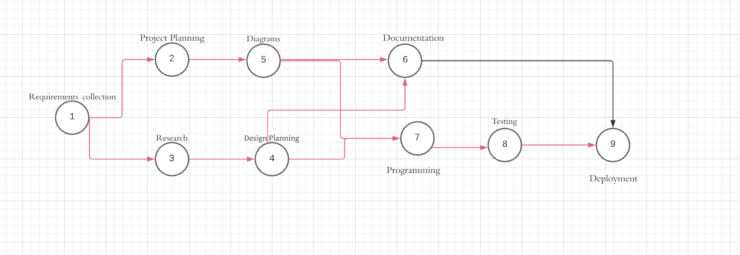
NETWORK DIAGRAM

Slide 11
TARGET AUDIENCE

Slide 12
TARGET AUDIENCE
This product targets students in the age range 15-18 but can be used by anyone interested in playing interactive games.
Since the age of the users that are going to use this game is specified, we were focused to make this product likable for this range.

Slide 13
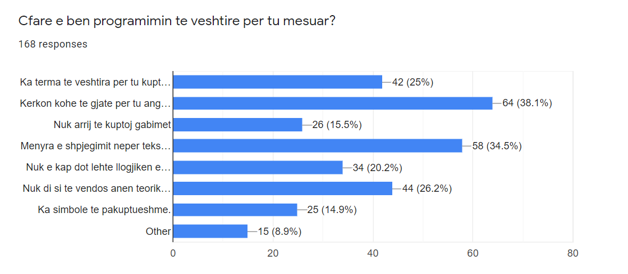
QUESTIONNAIRE
To have a successful game is essential to know what students don't like about coding. To gather that information, we conducted a survey where 168 students from both private and public schools gave their opinion regarding their difficulties in this field.

Slide 14
DIAGRAMS

Slide 15
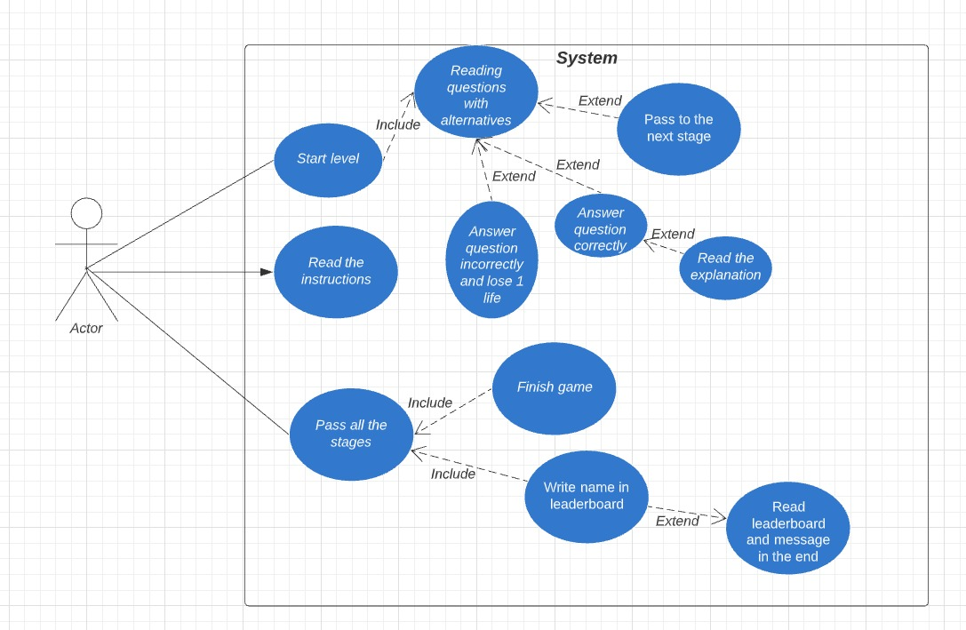
UML USE CASE

Slide 16
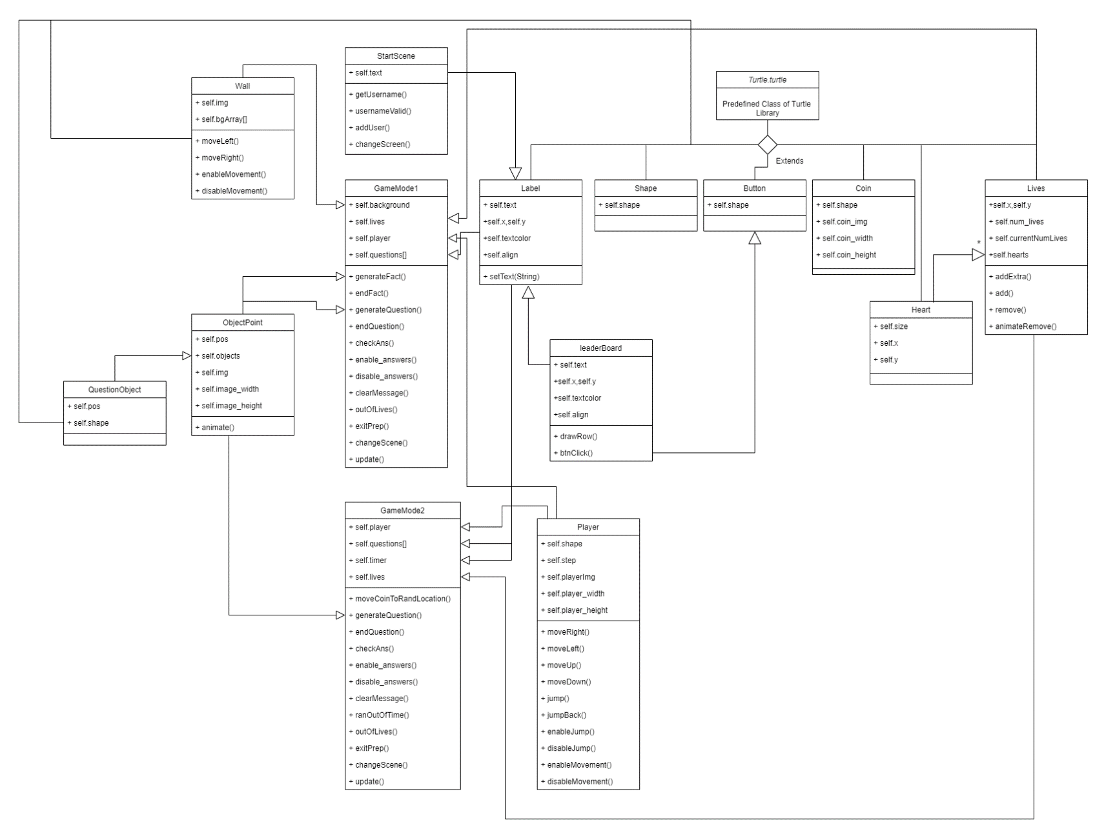

Slide 17
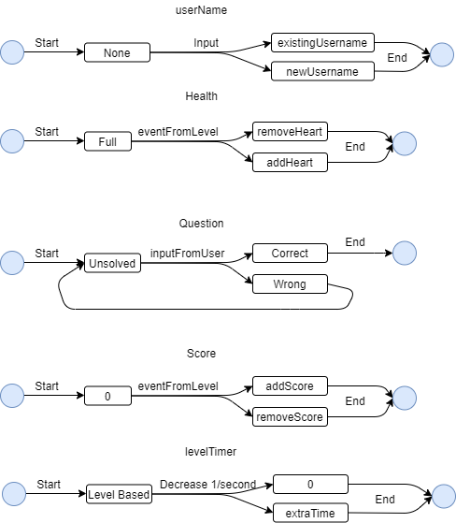
STATE DIAGRAM

Slide 18
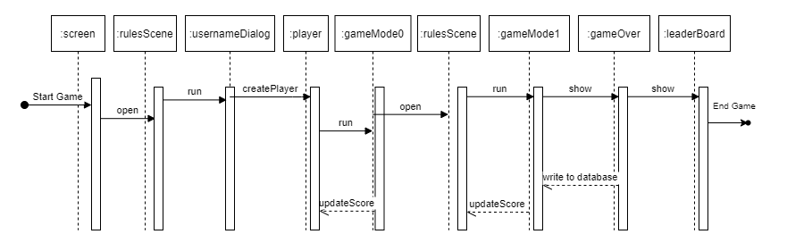
SEQUENCE DIAGRAM

Slide 19
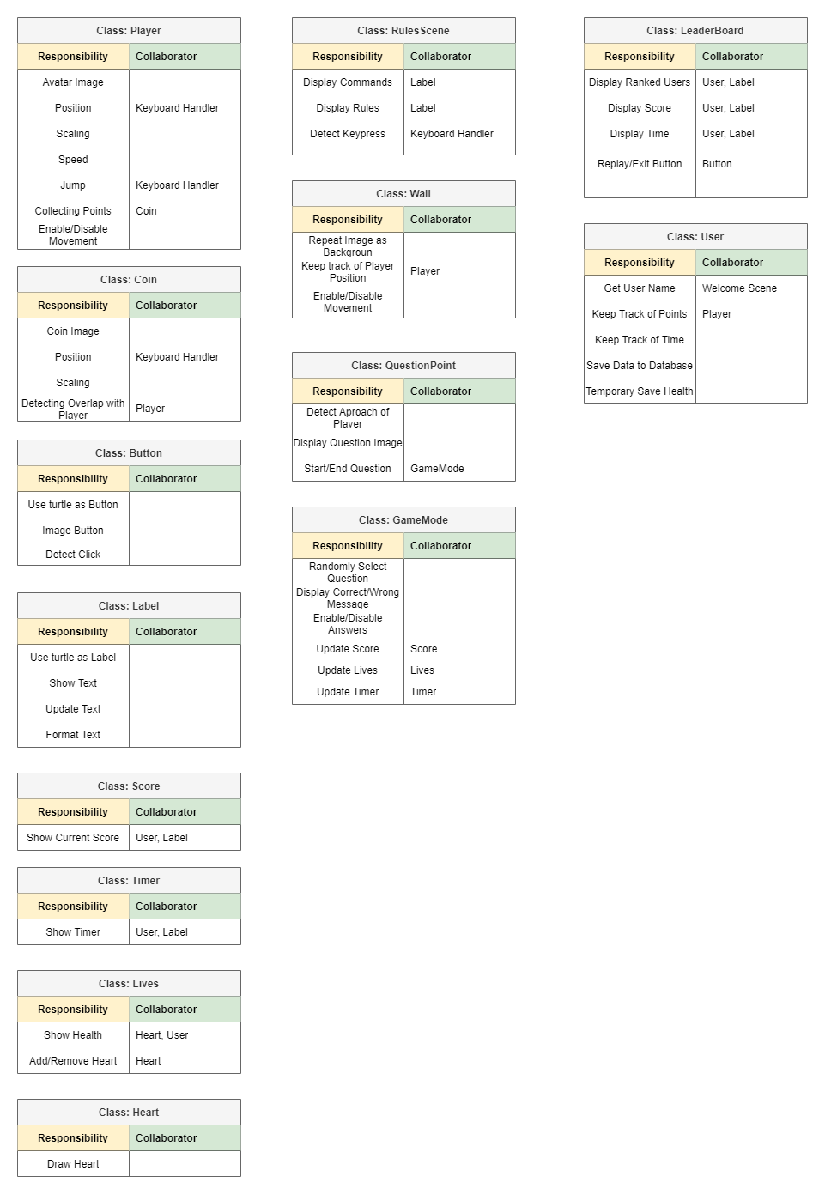
CRC MODELING

Slide 20
GAME DESIGN

Slide 21
GAME ELEMENTS
We had to make some decisions regarding the game. First, what the user will see most:
The character the player will operate will be a small fox. The orange creates contrast between the other elements in the game and the color used is not hard on the eye.
Another important part is the background of the game. The background gives the game a fresh look. The color palette consists of a soft blue in a futuristic background, fitting to programming. The soft blue induces a calm mind and aids in concentration.

Slide 22


GAME CHARACTER

Slide 23
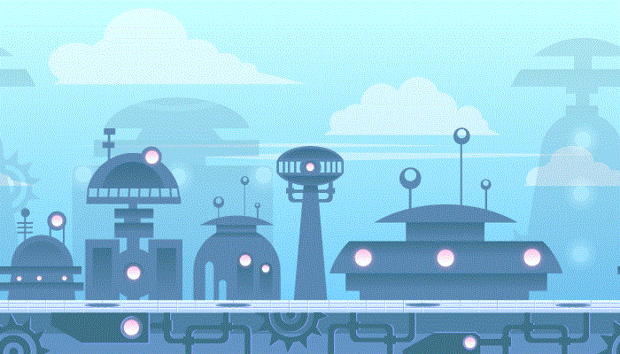
THE BACKGROUND THAT WE CHOOSE

Slide 24
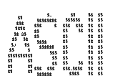
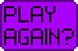




OTHER ELEMENTS

Slide 25
HOW DOES THIS GAME WORK?

Slide 26
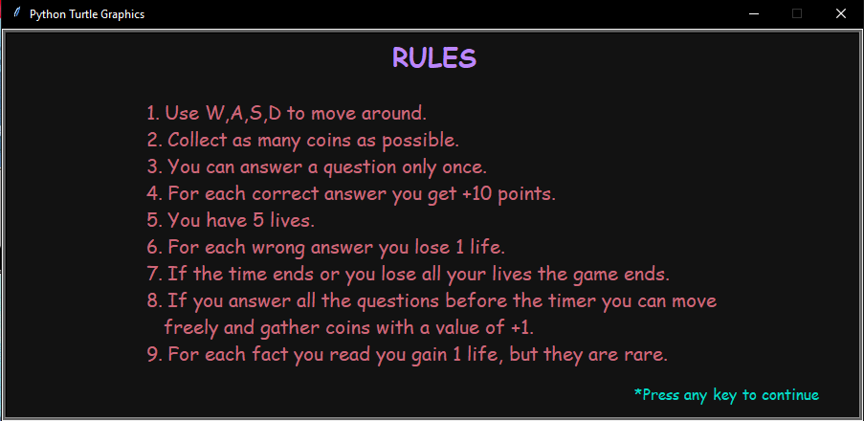

Slide 27
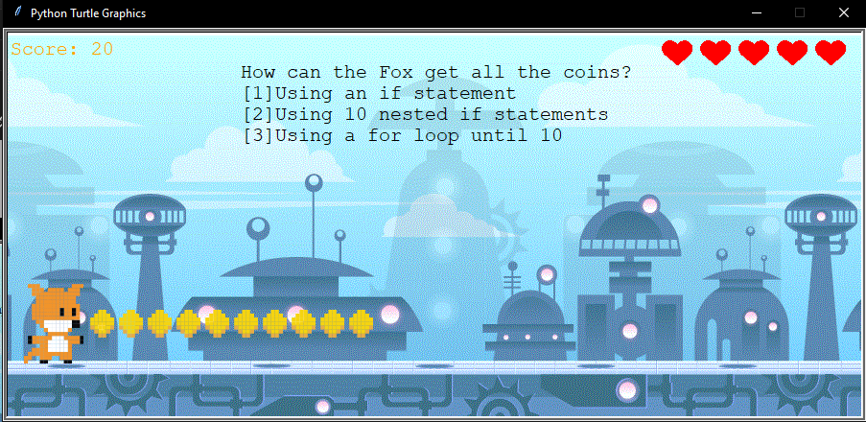

Slide 28
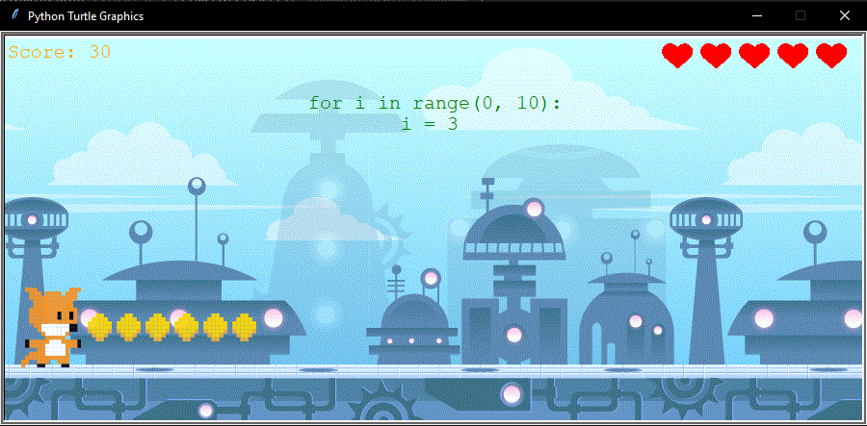

Slide 29
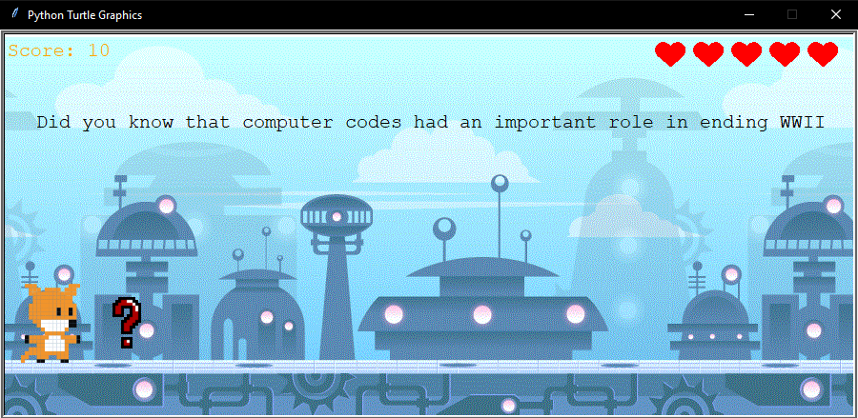
CODING FACTS

Slide 30
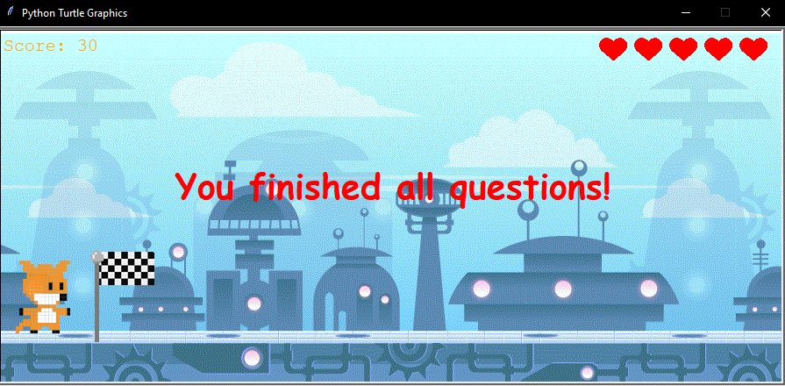

Slide 31
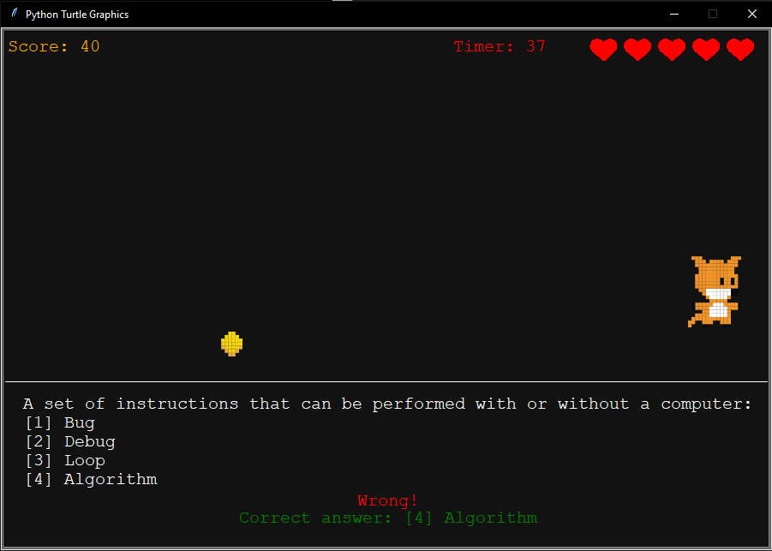

Slide 32
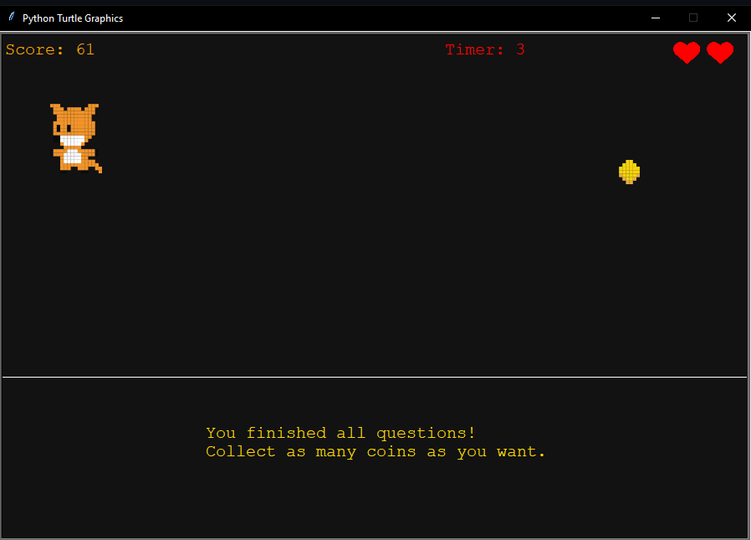

Slide 33
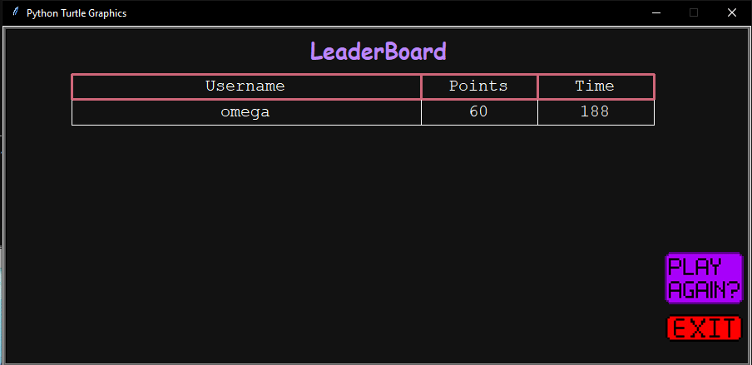

Slide 34
Workspace
Trello
GitHub
WhatsApp

Slide 35

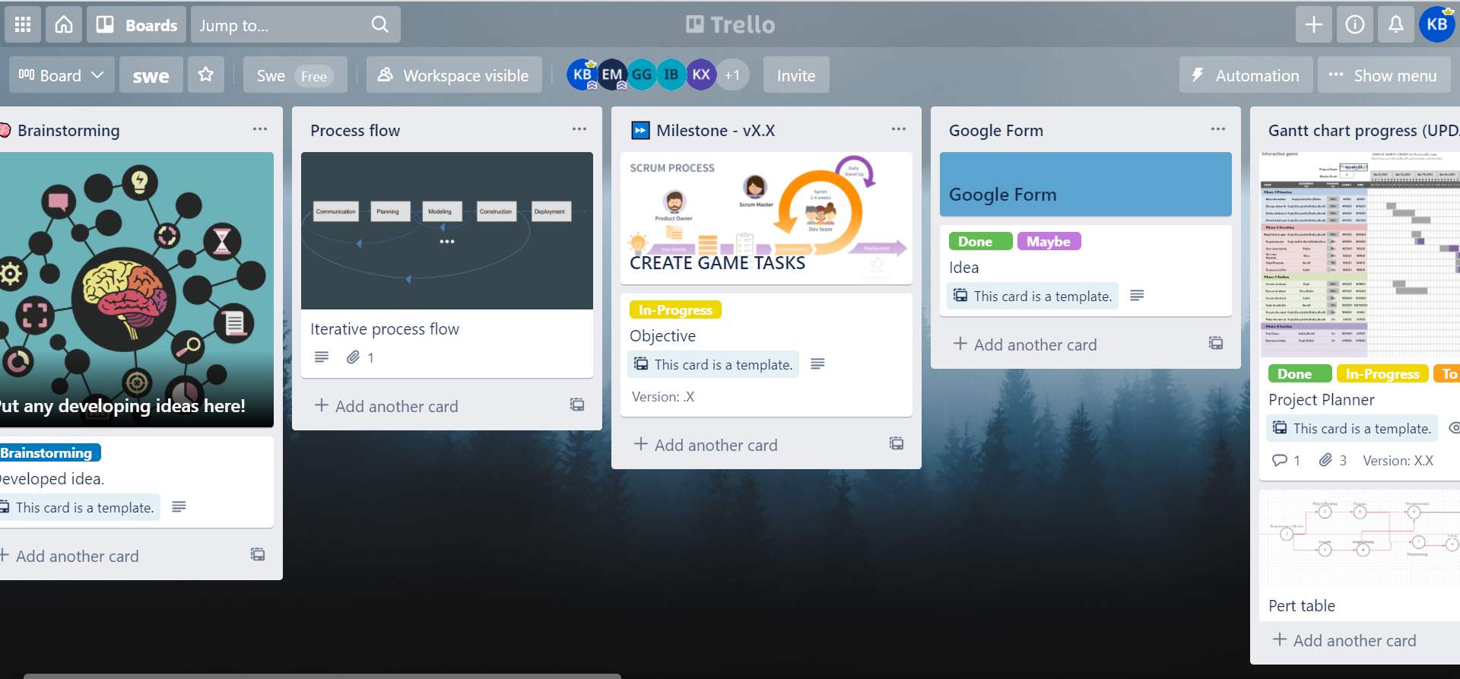
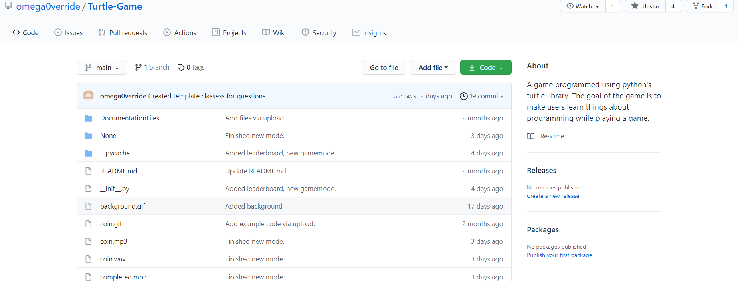

Slide 36
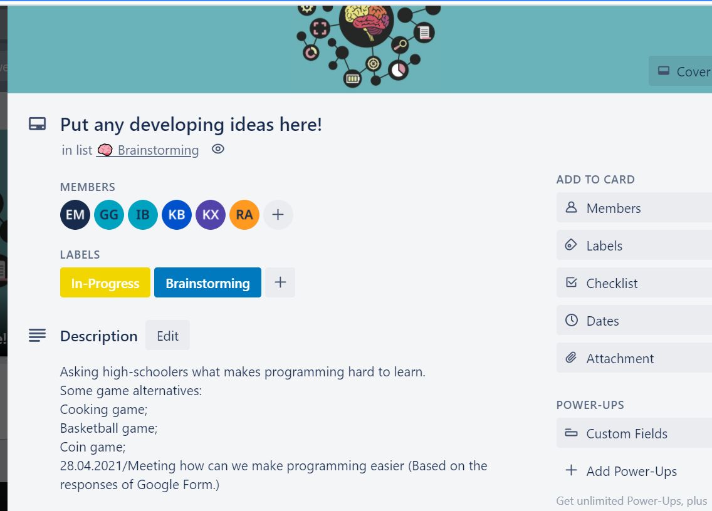
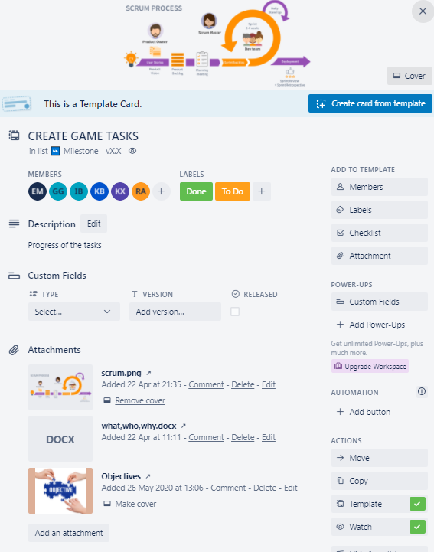
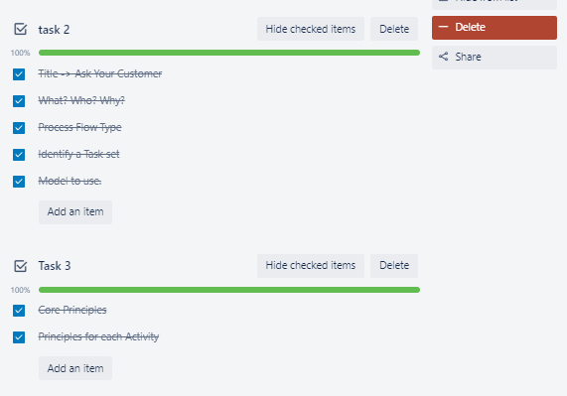

Slide 37
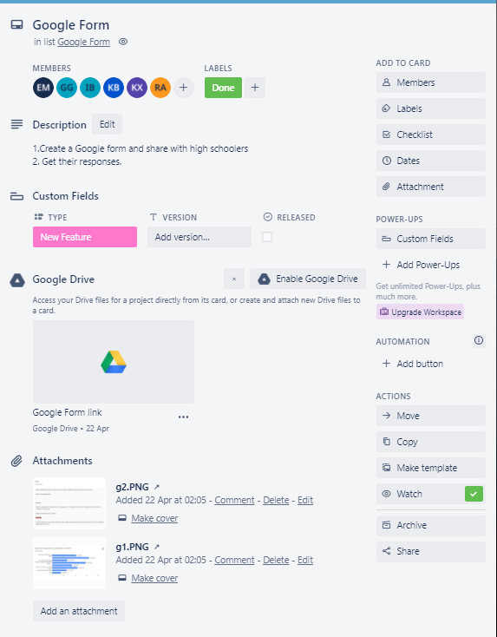
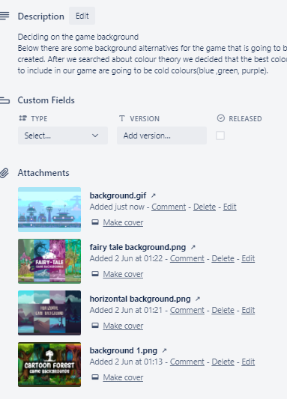
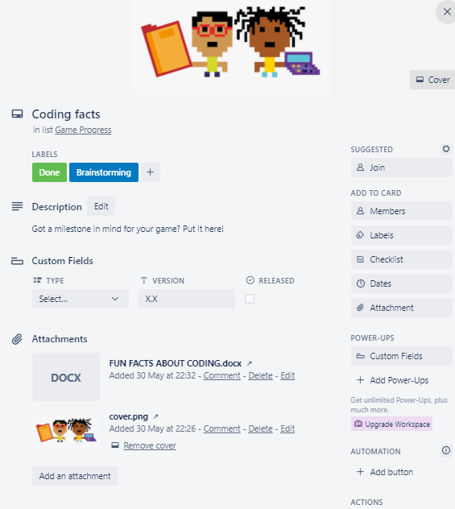

Slide 38
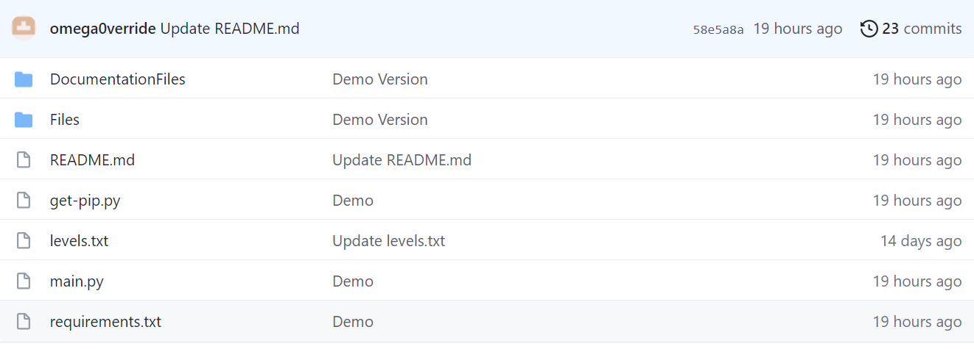
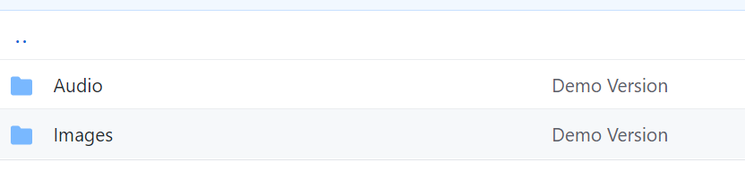
GITHUB SCREENSHOT

Slide 39
THANK YOU!

